Slide 1
Software Requirements and Design Document
for Solo Store Prepared by Muhammad Abbas, Shaffin Imam, Furqan Jahangir NUCES FAST Islamabad Date: 27-11-2024

Slide 2
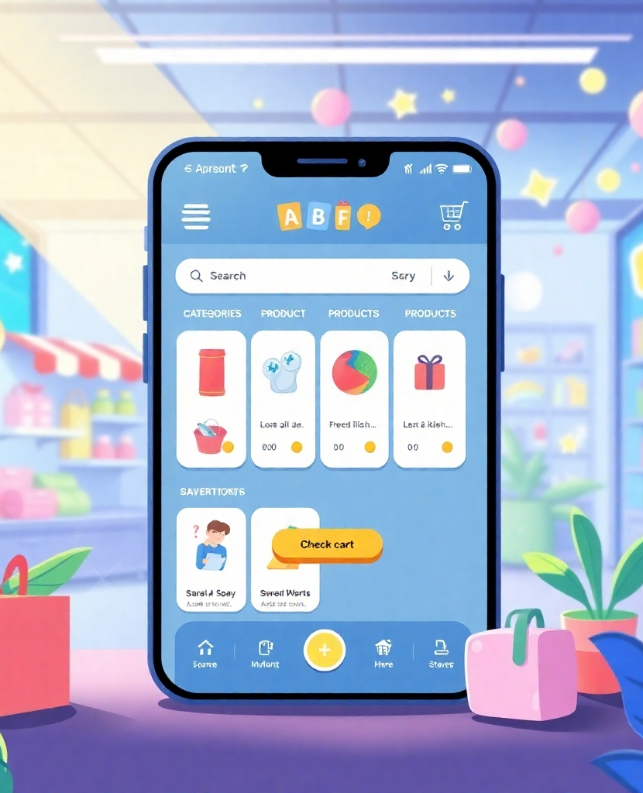
Purpose of SoloStore
The purpose of SoloStore is to develop a user-friendly e-commerce application that allows users to browse, search, and purchase products online seamlessly.
Customers: Search for products, add to cart, and place orders.
Store Owners: Manage inventory, update product details, and handle orders.
Administrators: Oversee the system and manage user roles for a secure experience.

Slide 3

Product Scope
SoloStore is an e-commerce application that enhances the online shopping experience.
Browsing: Users can easily browse through various products.
Searching: Efficient search functionality for quick product discovery.
Purchasing: Seamless purchasing process for customers.
Reviews: Customers can leave reviews to enhance product visibility.
Management: Store owners can manage products, while administrators oversee the system.

Slide 4
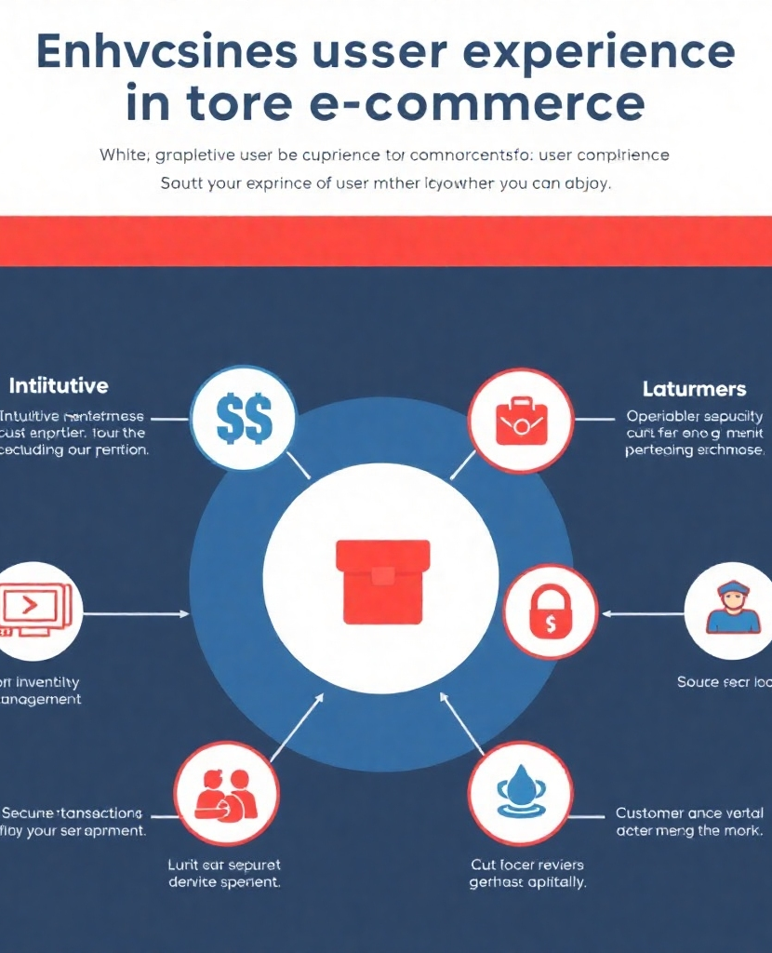
Objectives of the Project
The project aims to enhance user experience through several key objectives.
Provide an intuitive interface for customers.
Enable store owners to manage inventory and analyze sales data.
Ensure secure transactions and protect user data.
Improve customer satisfaction with review functionality.

Slide 5

Problem Statement
Traditional shopping methods present several challenges that SoloStore aims to address.
Time-Consuming: Shopping in physical stores can be inefficient.
Lack of Convenience: Limited accessibility and flexibility.
Manual Efforts: Increased effort required for both customers and store owners.

Slide 6
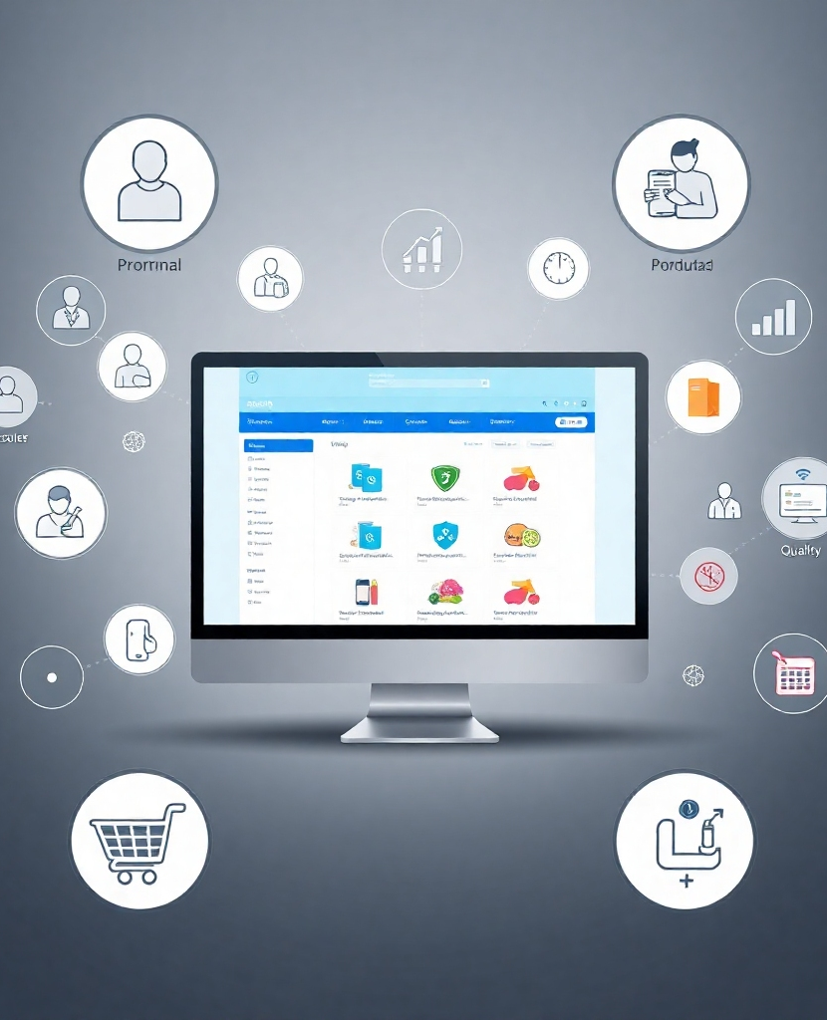
Overall Description
The overall product description includes various aspects of SoloStore.
Product Perspective: A modern e-commerce platform.
Functions: Essential functionalities for users and administrators.
Use Cases: Various scenarios illustrating user interactions.
Nonfunctional Requirements: Performance, safety, security, and quality attributes.

Slide 7
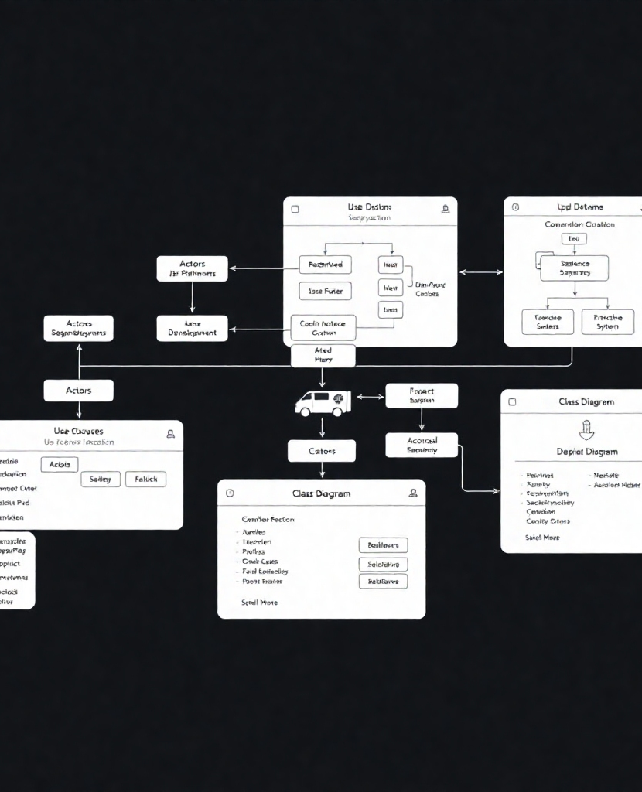
Diagrams and Models
Key diagrams illustrate the structure and flow of the SoloStore application.
Use Case Diagram: Visual representation of user interactions.
System Sequence Diagram: Flow of operations within the system.
Class Diagram: Structure of the application components.
Deployment Diagram: Overview of the system architecture and deployment.

